Slide 1


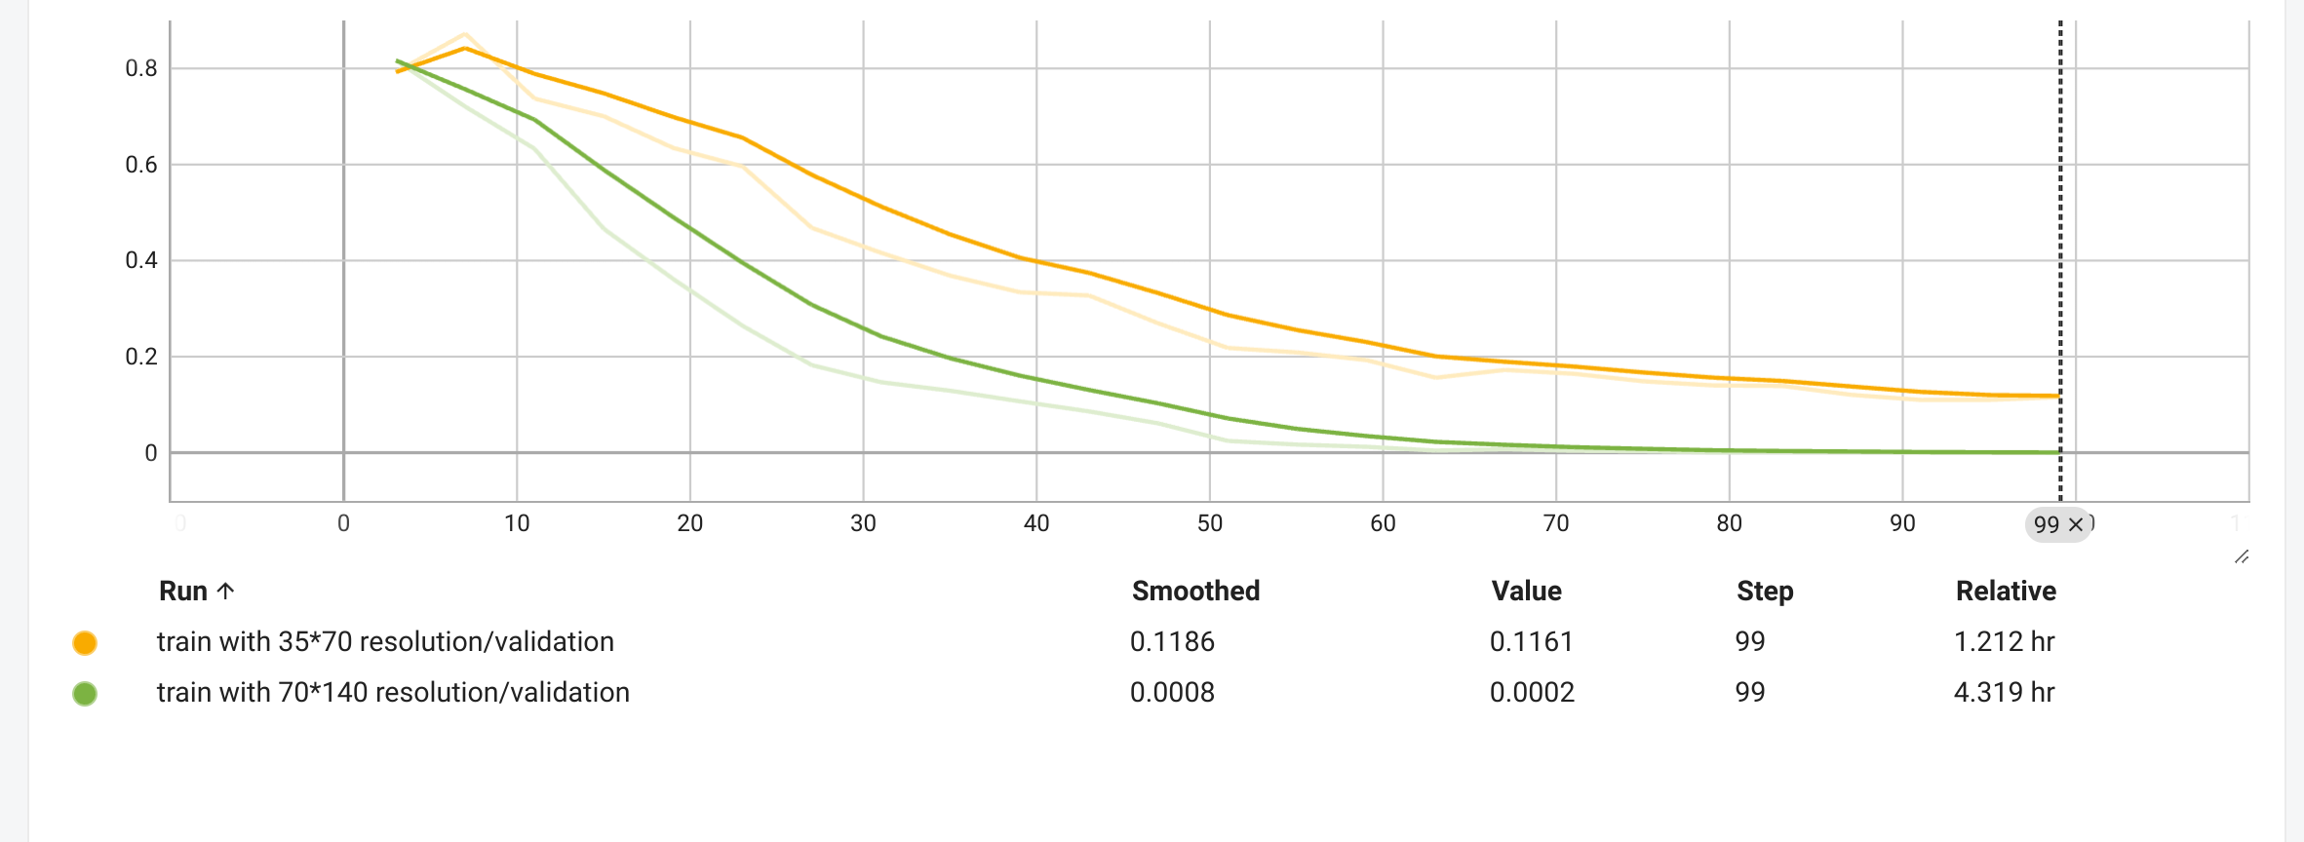
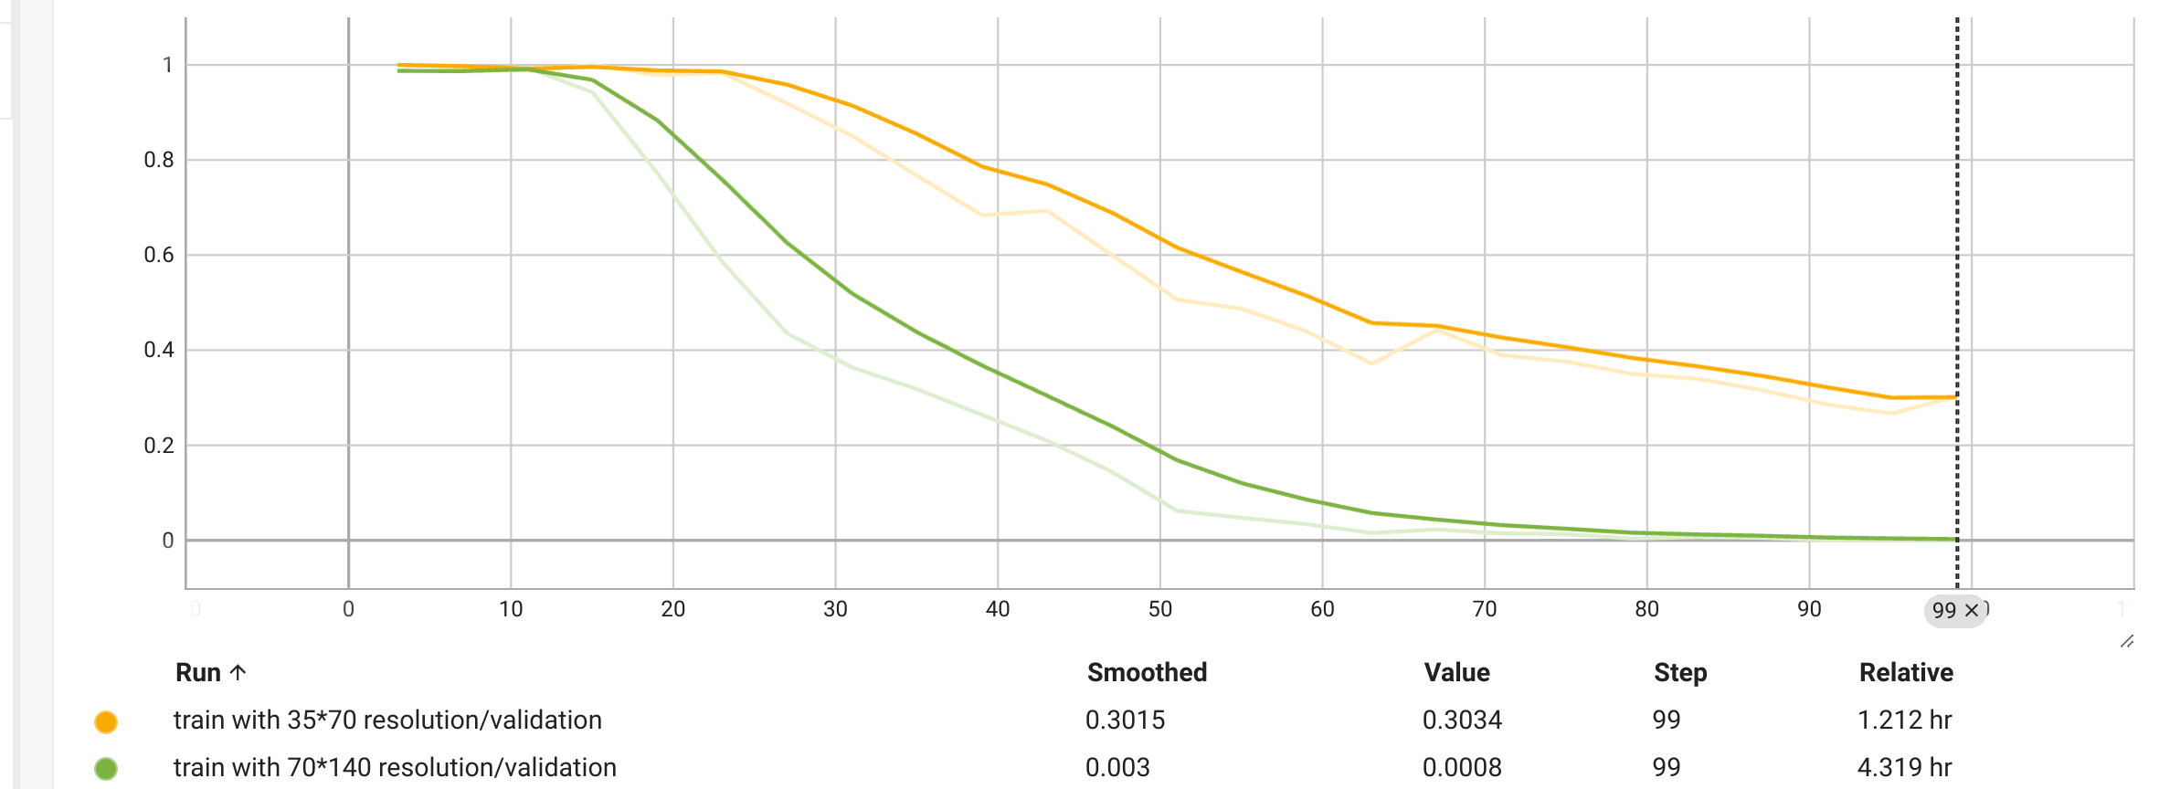
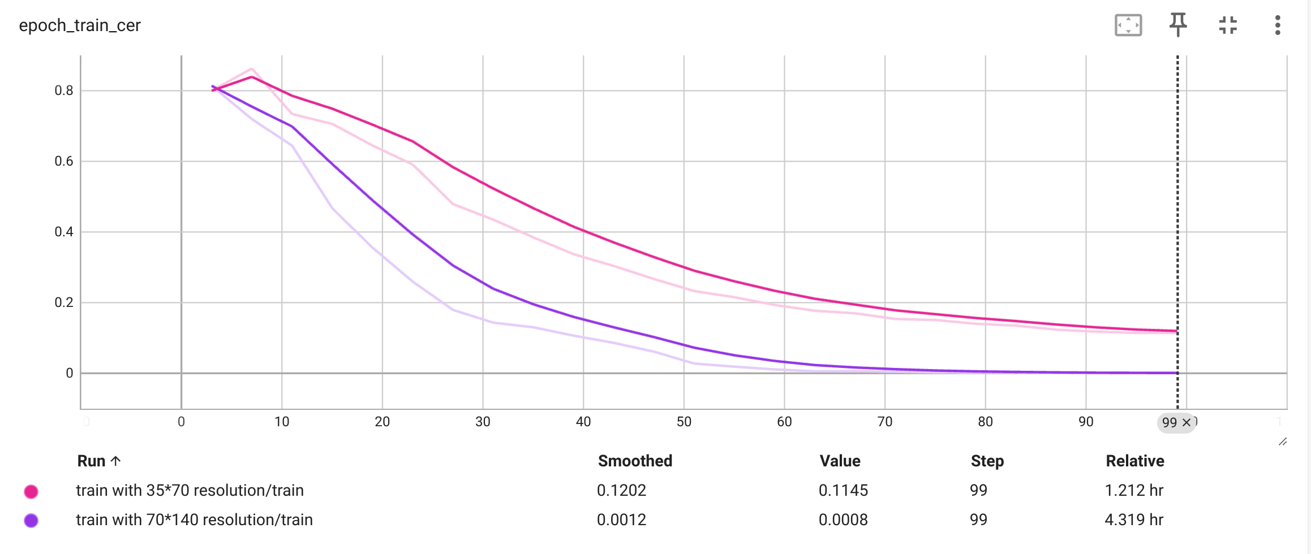
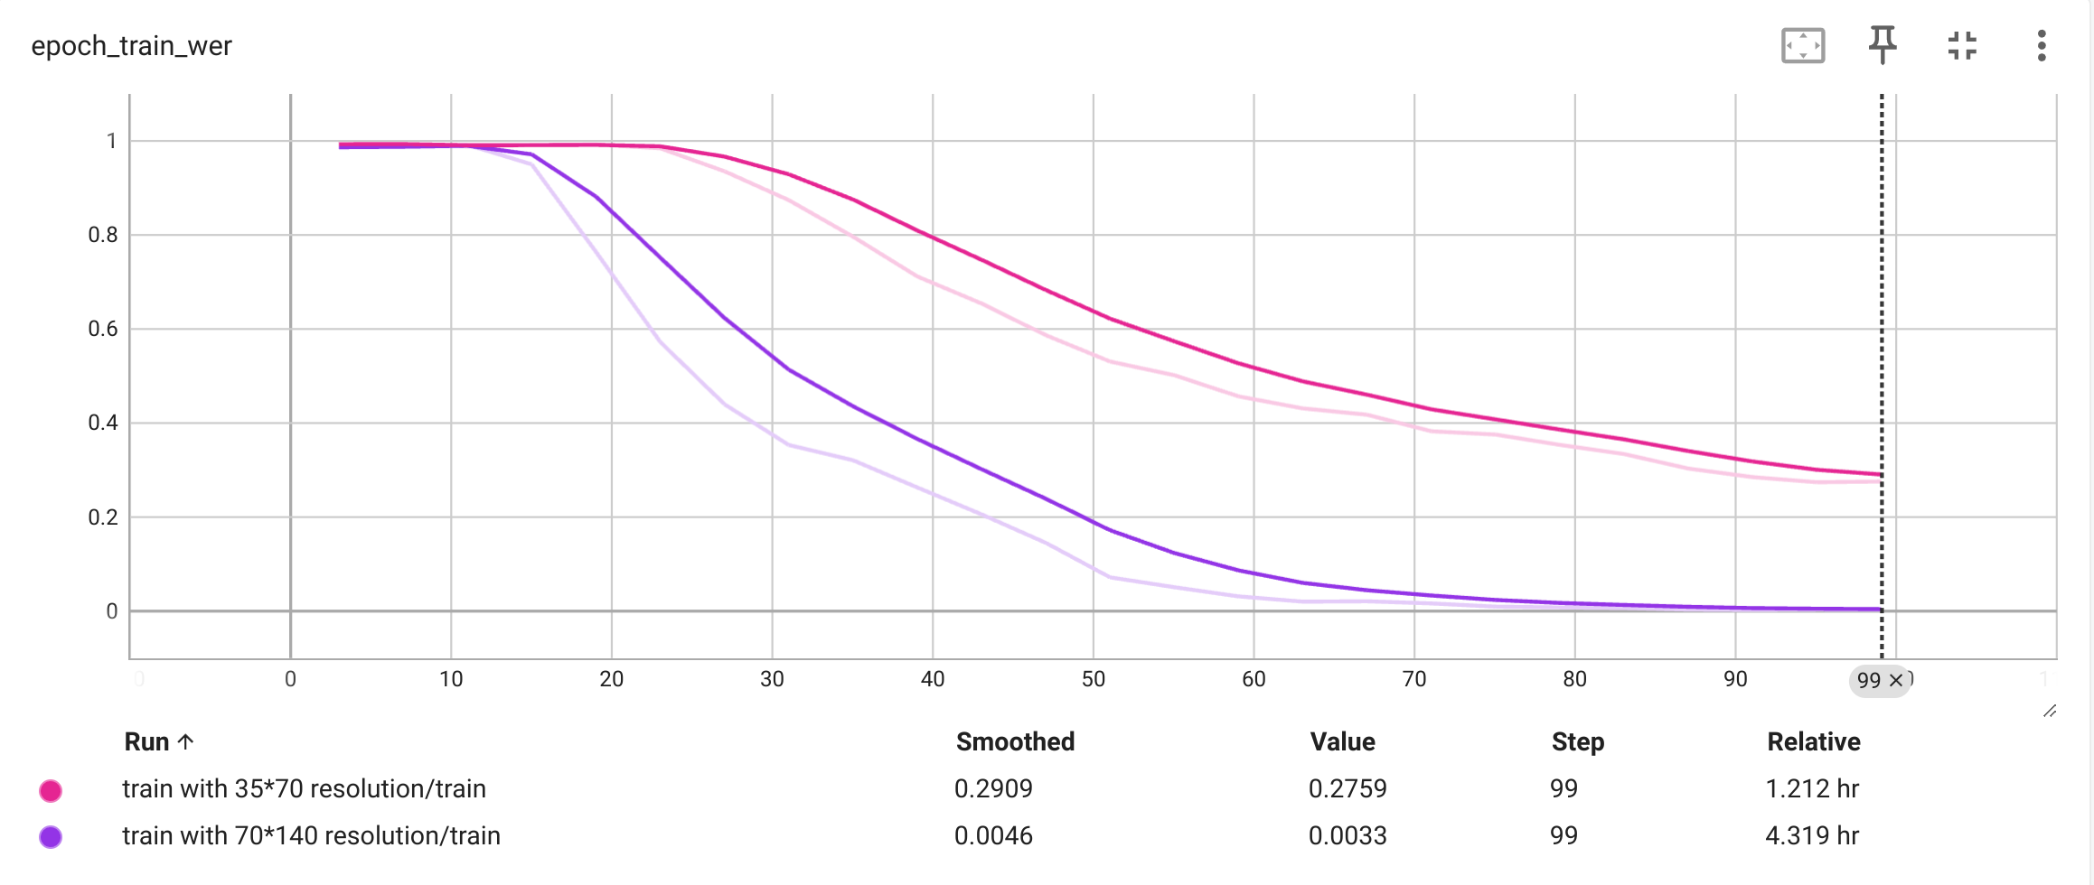
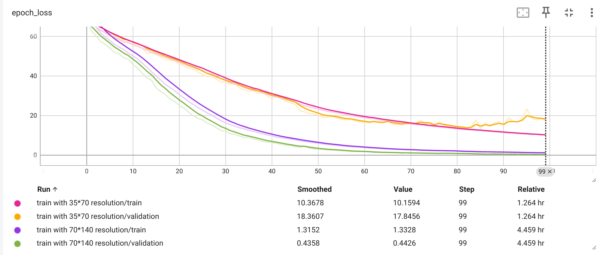
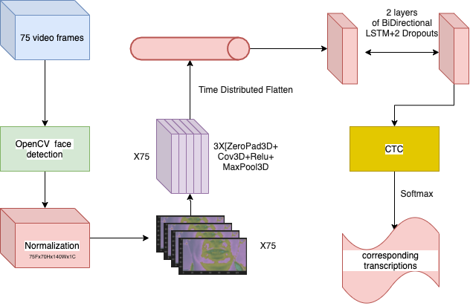
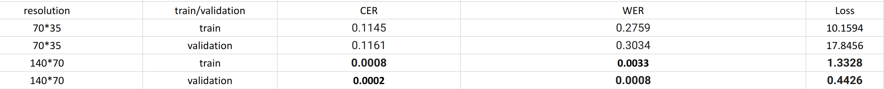
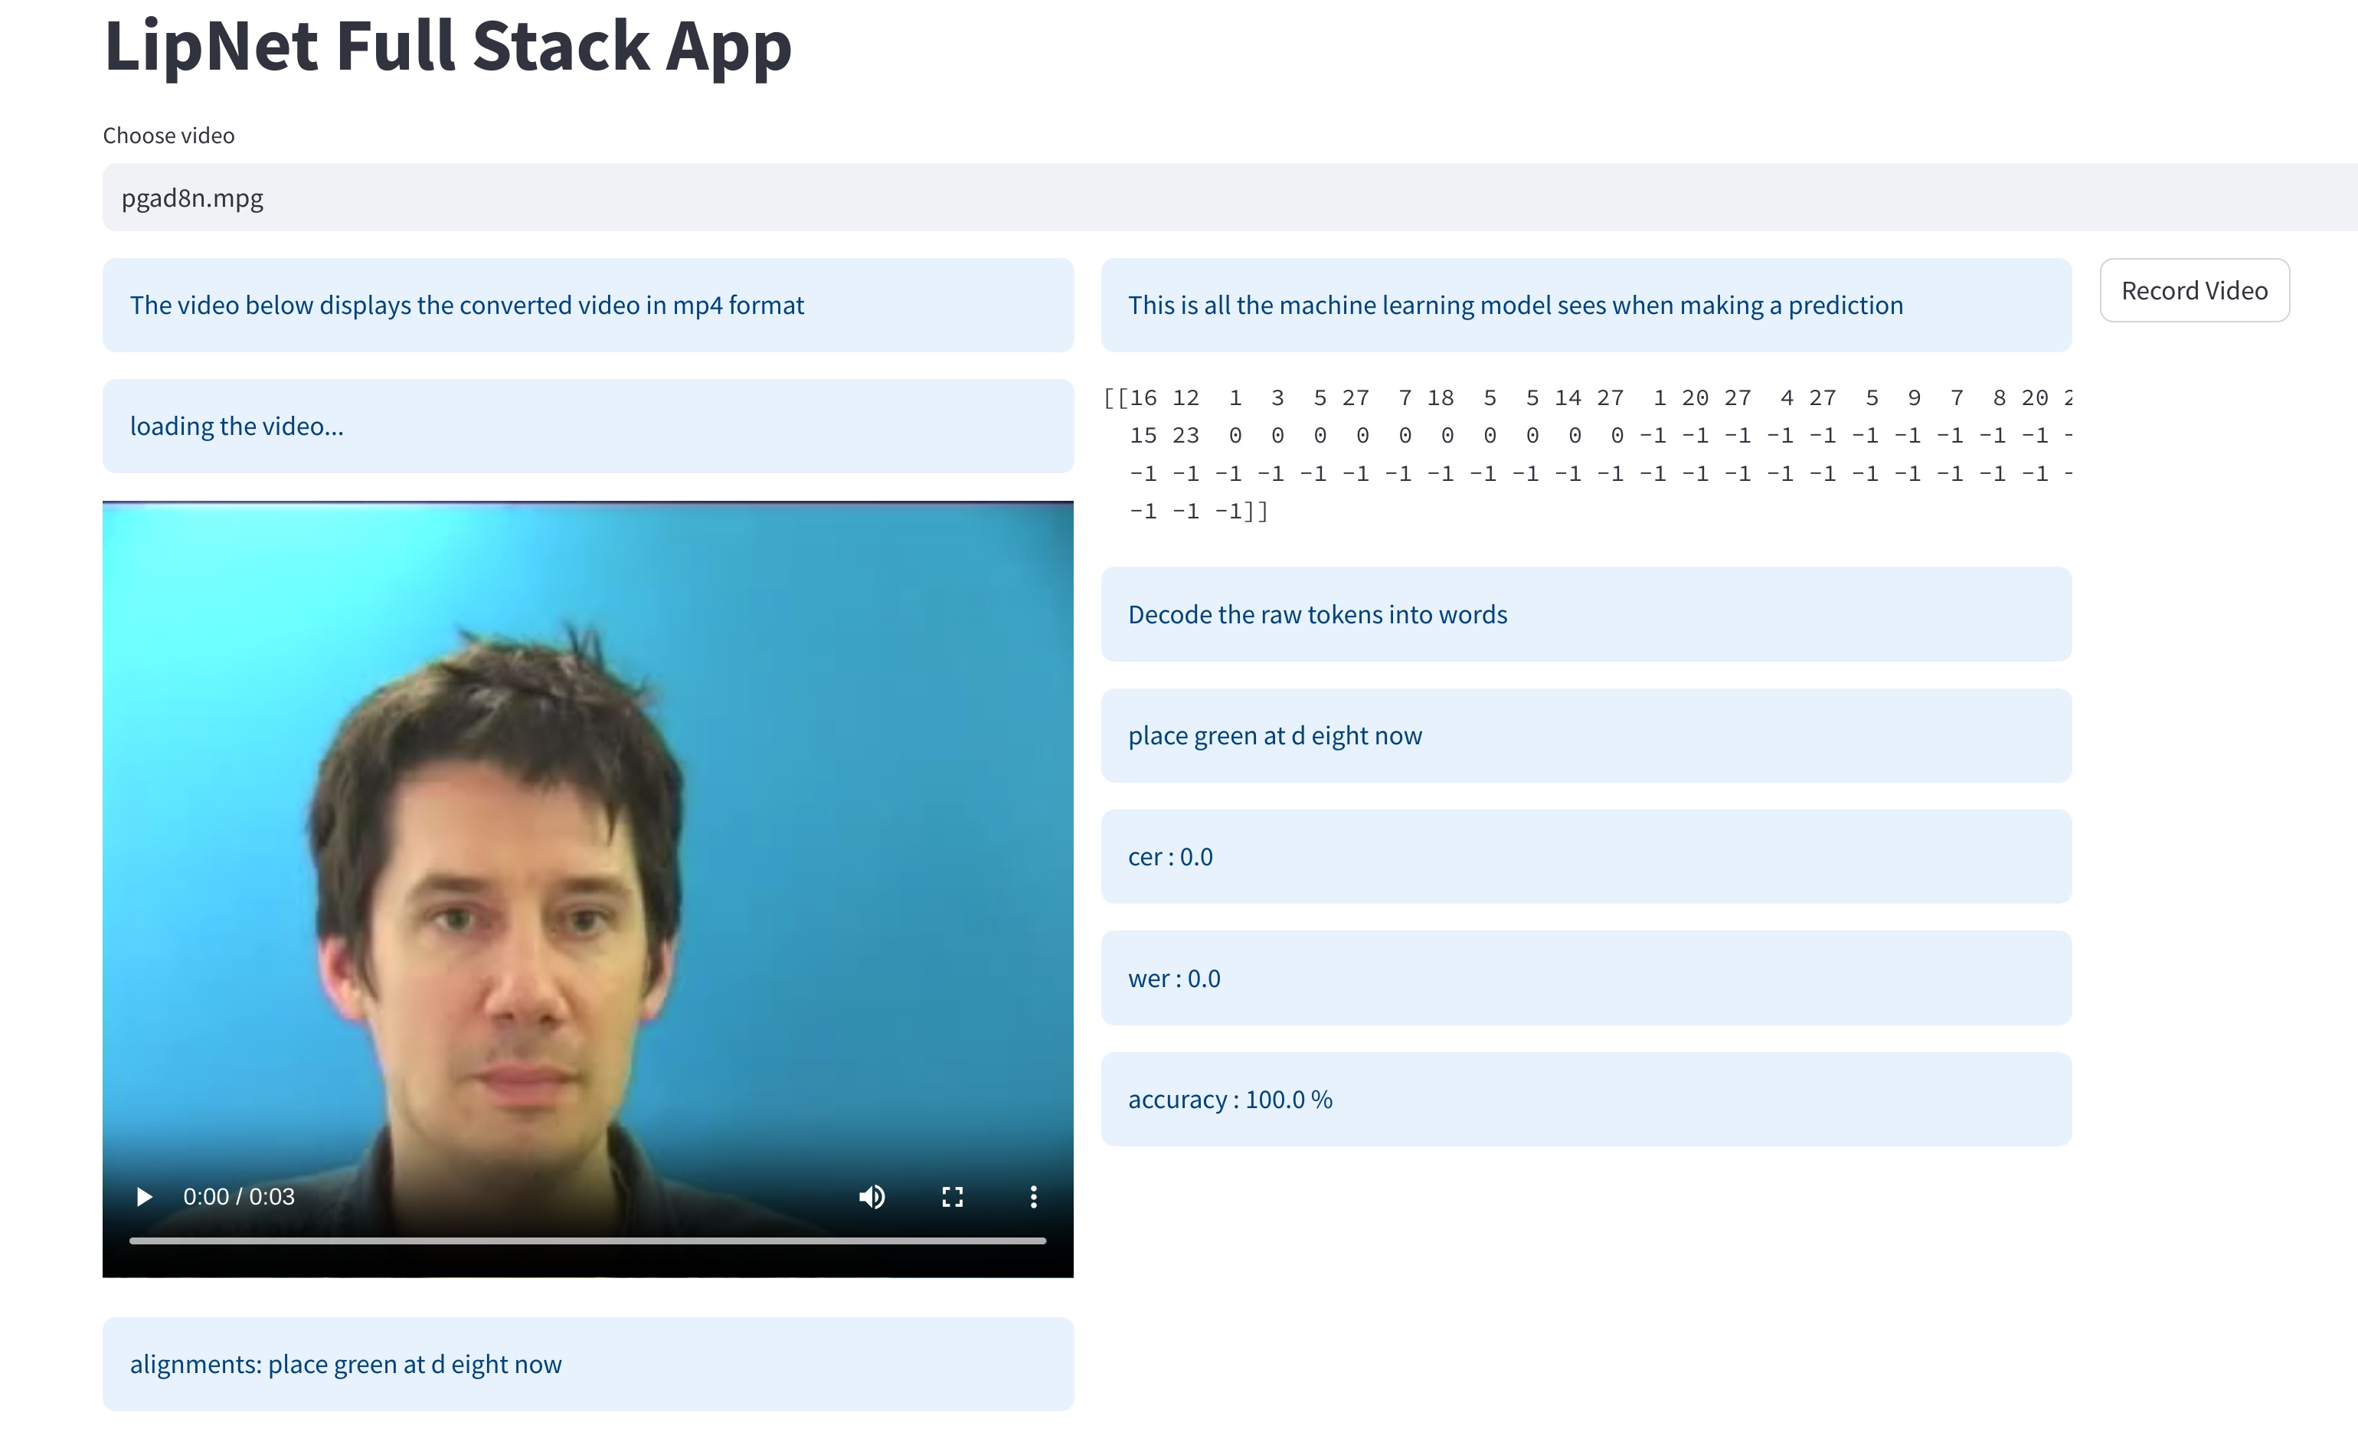

Deciphering Silent Speech: A Multi-dimensional Neural Network Approach Using Conv3D, LSTM, and CTC for Lip-reading
Scan for Code
Zhenyi Li¹, Enda Farrell ²
¹ Master student, Software Engineering – MSc
² Supervisor, Department of Computer and Software Engineering, Technological University of The Shannon: Midlands Midwest
Abstract
dynamics in both forward and backward directions of the temporal sequence. Two such LSTM layers are stacked, each followed by a dropout layer to prevent overfitting.
The output of the LSTM layers is then passed to a Connectionist Temporal Classification (CTC) layer, which allows the network to align the input sequences with the output sequences without pre-segmented training data. CTC is particularly useful for tasks like lip reading, where the alignment between the input video frames and the spoken words is not explicitly known.
Finally, the CTC layer's output is processed by a softmax activation function to produce a probability distribution over the possible transcriptions for each time step. The model aims to transcribe the spoken content from the video frames, converting the visual information into corresponding text.
In this investigation, we examined the impact of image resolution on the performance of lip-reading models, with a focus on character error rate (CER) and word error rate (WER) as primary metrics. Two models were rigorously trained, one at a low resolution of 35x70 pixels and the other at a higher resolution of 70x140 pixels.The dataset we are using is one of the grid corpus datasets, which is a widely used dataset in the field of lip reading. The results were telling: the high-resolution model achieved a CER of 0.0008 and a WER of 0.0033, in contrast to the low-resolution model's CER of 0.3034 and WER of 0.3015. This indicates a significant performance leap with higher resolution inputs. However, the trade-off for precision was computational time, with the higher resolution training taking 4.319 hours, compared to 1.212 hours for the lower resolution. To translate these findings into practical insights, we have developed an online platform where users can gauge the model's accuracy in real-time scenarios. The direct comparison of CER and WER across resolutions highlights the delicate balance between model accuracy and computational efficiency in the field of automated lip-reading.
Result
Introduction
Lip-reading is a complex visual task that involves deciphering speech from the movements of the lips, tongue, and face without auditory input. It is particularly critical for those with hearing impairments and has extensive applications in noisy environments where audio signals may be compromised. The advent of deep learning has significantly enhanced the prospects of automating this task, but achieving high accuracy depends on multiple factors including the resolution of the input data.
In this paper, we investigate the influence of input resolution on the performance of a lip-reading model that integrates three-dimensional convolutional neural networks (Conv3D), Long Short-Term Memory networks (LSTM), and Connectionist Temporal Classification (CTC) for training. This combination leverages spatial feature extraction through Conv3D, temporal dynamics captured by LSTM, and an end-to-end training approach offered by CTC, which is well-suited for sequence prediction problems such as lip-reading.
Our study compares the character error rate (CER) and word error rate (WER) of two models: one trained on low-resolution (35x70 pixels) and the other on high-resolution (70x140 pixels) datasets. These metrics gauge the models' abilities to accurately recognize and reproduce characters and words from visual information alone. By presenting a side-by-side analysis of models trained with varying input resolutions, we aim to illuminate the trade-offs between computational efficiency and the precision of lip-reading models. Furthermore, the paper discusses the implementation of an online platform to assess the practical capabilities of the trained models in real-world scenarios.
Fig 2: The Line chart for WER and CER
We trained two models on the grid corpus dataset, one at a low resolution of 35x70 pixels and the other at a higher resolution of 70x140 pixels. each model was trained for 100 epochs, with a batch size of 4 and a learning rate of 0.0001. The high-resolution model achieved a significantly lower CER of 0.0008 and WER of 0.0033, compared to the low-resolution model's CER of 0.3034 and WER of 0.3015. as shown in the table below, the high-resolution model outperformed the low-resolution model across all metrics, indicating the importance of input resolution in lip-reading tasks.
Experimental Setup
Fig 3: The Line chart for loss
Table 1: comparison of Performance
The full-stack online application utilizes Streamlit for web deployment, TensorFlow for the deep learning model operations, and OpenCV for computer vision tasks.
Fig 1: The processing pipeline of the model
Fig 4: Online Application
The system starts by taking a sequence of 75 video frames as input. These frames undergo face detection using OpenCV, a library for computer vision tasks, to ensure the model focuses on the relevant area for lip reading. After detecting the face, the data is normalized to a fixed size of 75 frames with a resolution of 70x140 pixels and a single color channel (grayscale).
The normalized video data is then passed through a series of three-dimensional convolutional layers (Conv3D), each followed by a ReLU activation function and a 3D max-pooling layer. These Conv3D layers are designed to extract spatial-temporal features from the video sequence. Padding (ZeroPad3D) is applied to the input of the Conv3D layers to maintain the spatial dimensions after convolutions.
After feature extraction, the output is flattened across the temporal dimension to prepare for sequence modeling. This flattened output is fed into a bidirectional LSTM (Long Short-Term Memory) network, which is capable of learning long-term dependencies and capturing the
Conclusion
The developed lip-reading model, employing Conv3D and bidirectional LSTMs, demonstrated the potential of high-resolution inputs to reduce error rates. Deployed via a full-stack application with Streamlit, TensorFlow, and OpenCV, it sets the stage for practical use. Future efforts will focus on expanding the dataset and exploring sophisticated techniques such as Transformers to adapt to diverse environmental conditions.

